Slide 1
H-Fitness Website
2015314065
유효민

Slide 2
Project Objective
Providing information about h-fitness and member management
- User can register to gym / class
User can check trainer information and rating by other users
User can rate trainers

Slide 3
Functions
Join (회원가입)
Sign in and sign out(로그인 및 로그아웃)
Check class schedule(수업 고르기)
Register class(수업 등록)
Check trainer info(강사 이력 확인)

Slide 4
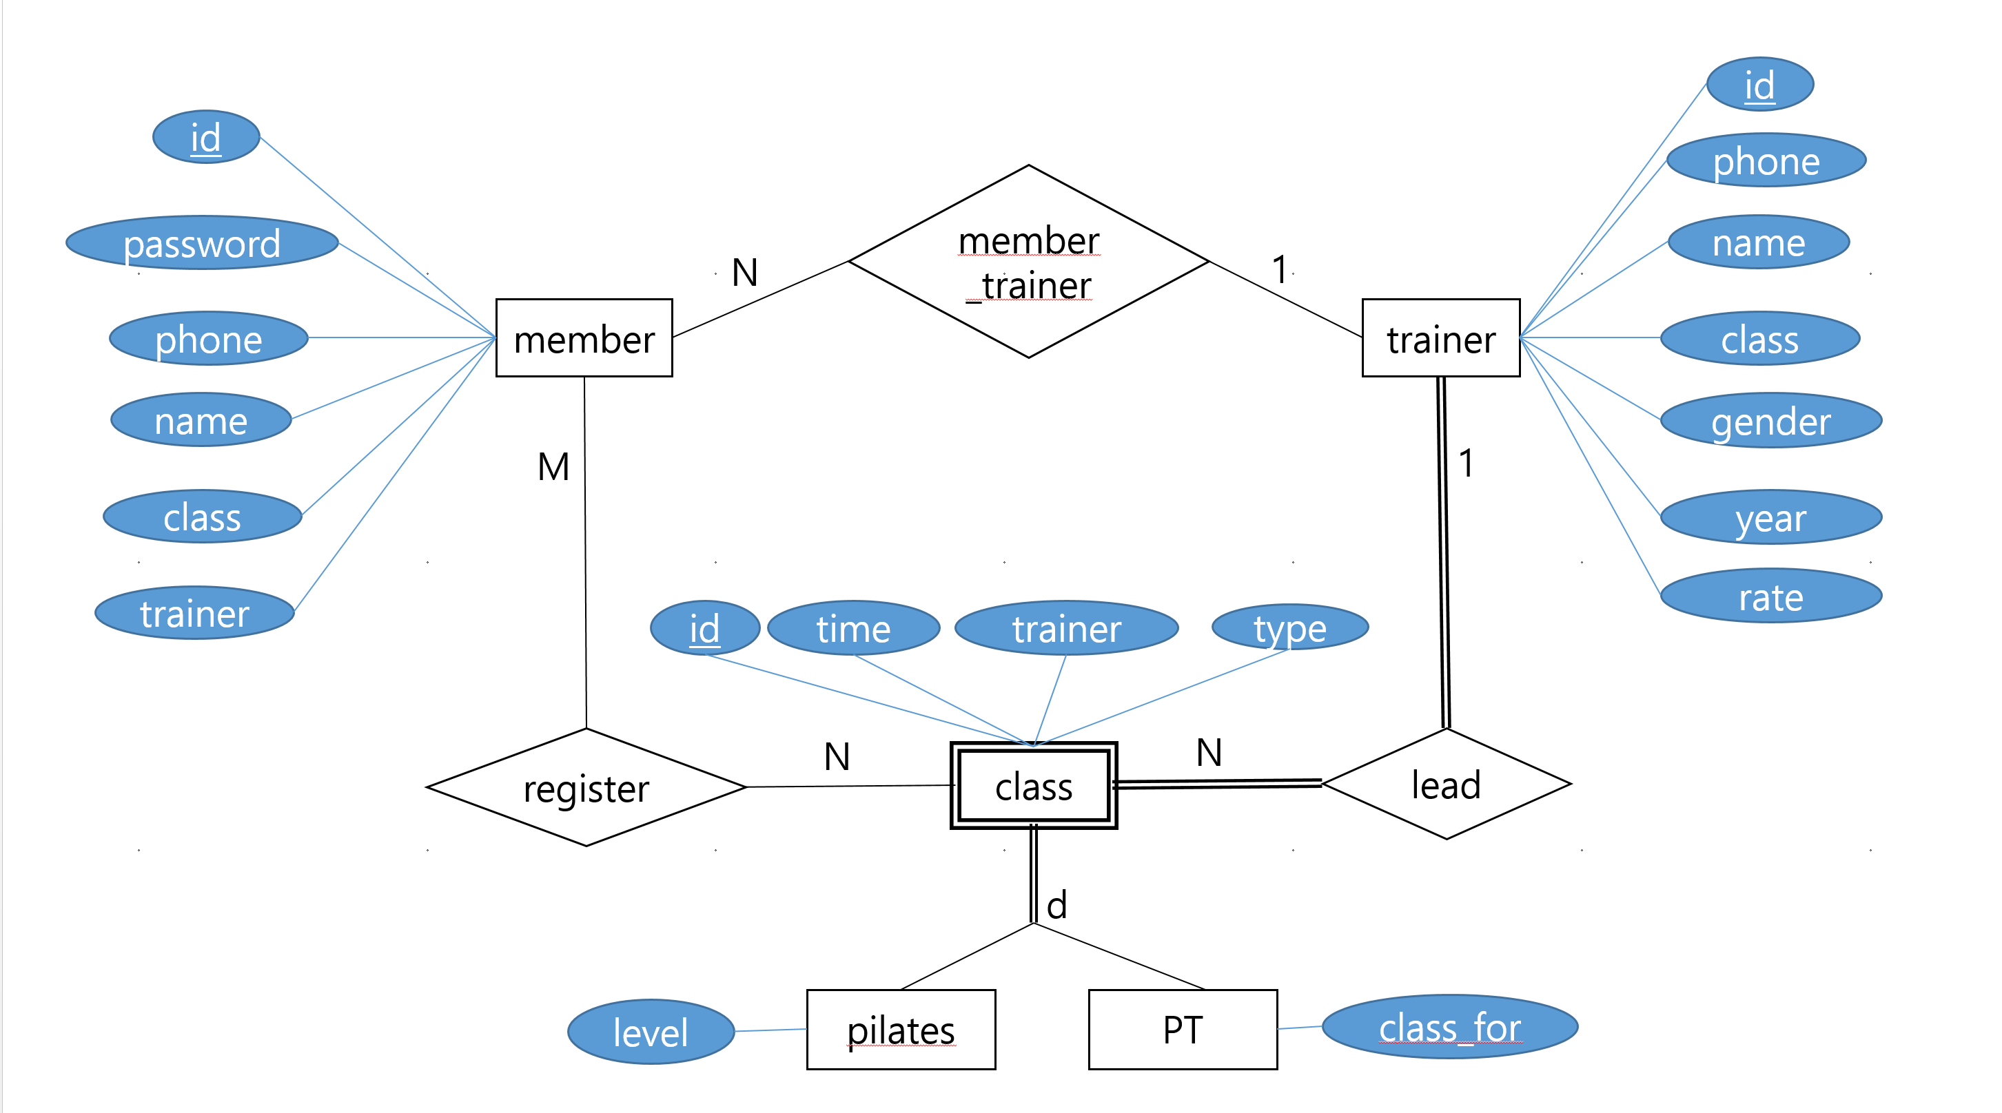
DB Design
ER diagram

Slide 5
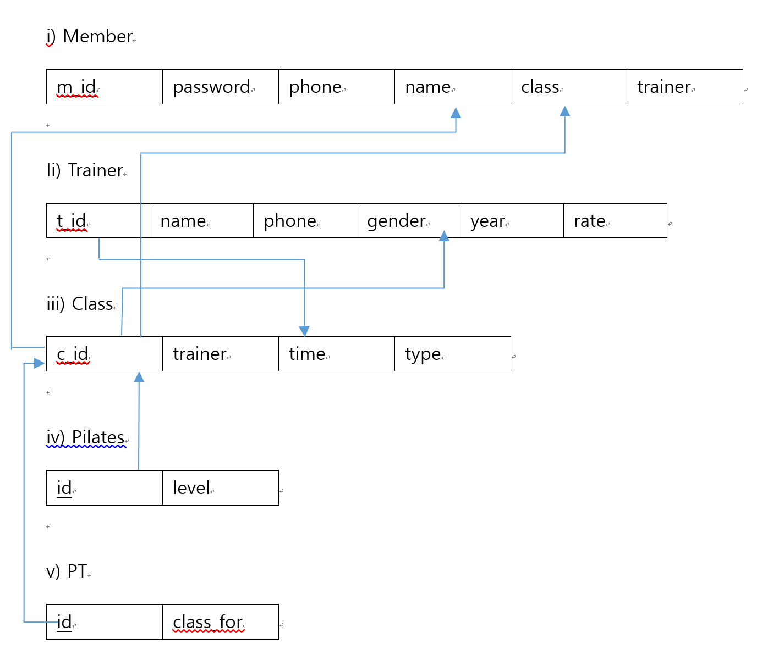
DB Design
Relational model

Slide 6

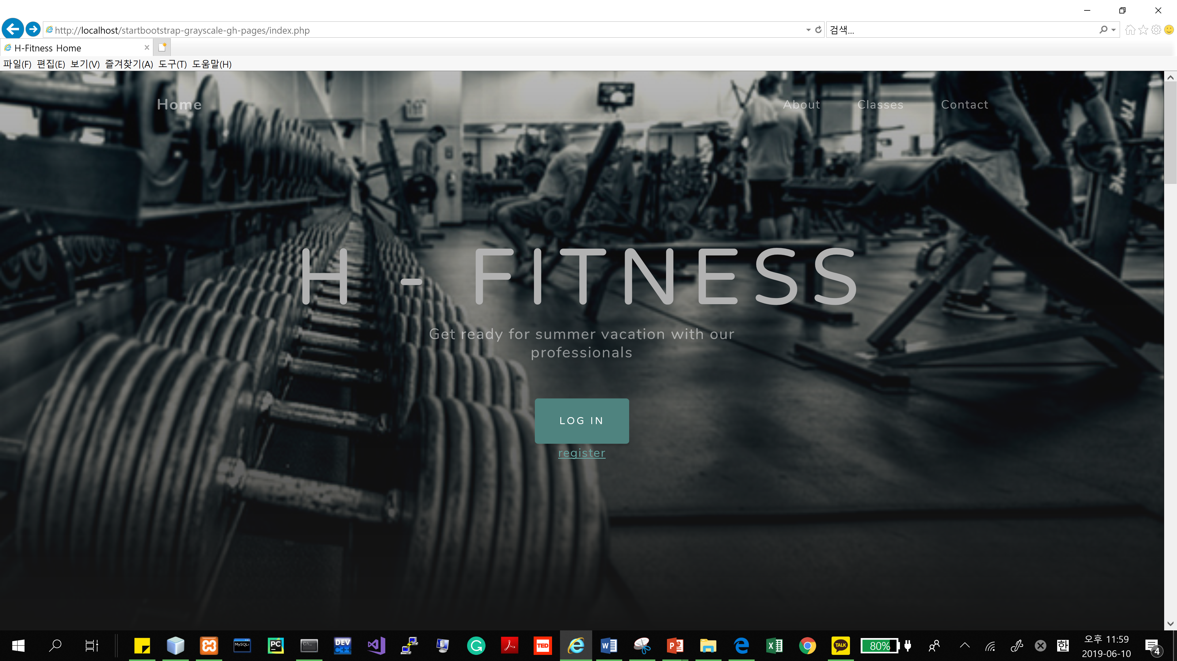
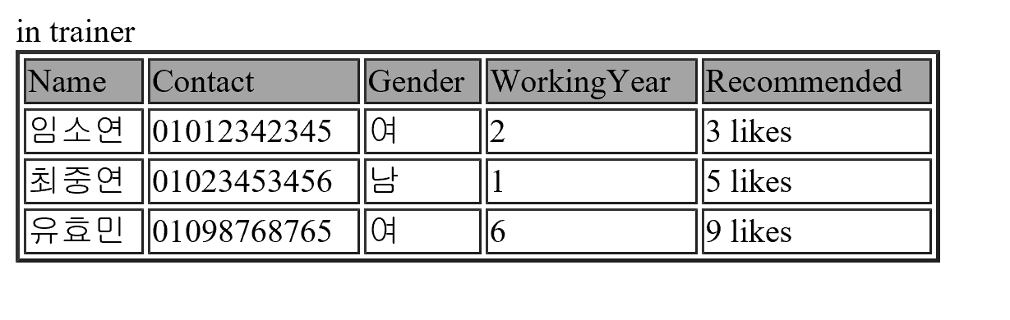
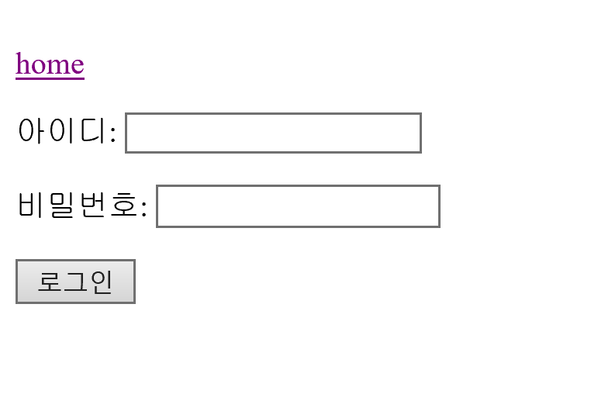
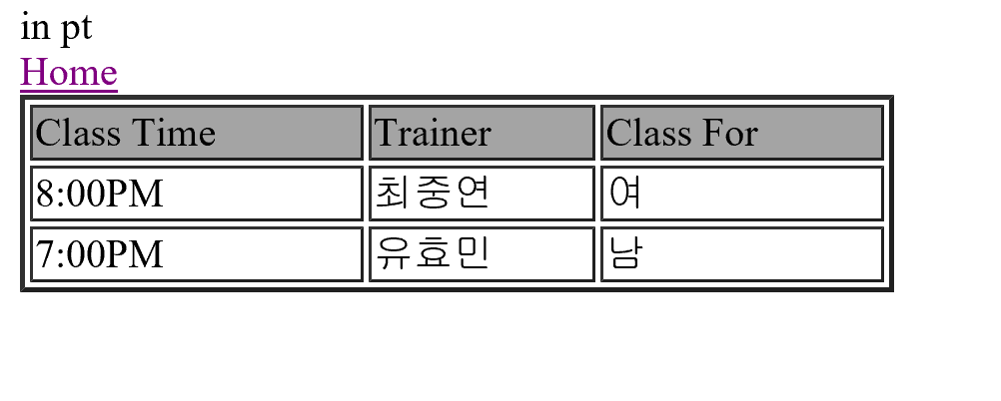
Demonstration

